Slide 1
VE230 Recitation Class 4
by Li Chunchao
2017/10/26

Slide 2
Short Review

Slide 3

Conductor
Property of conductor in electrostatic condition
Two model
Potential and Electric field
Method of images

Slide 4
Solving Problems

Slide 5
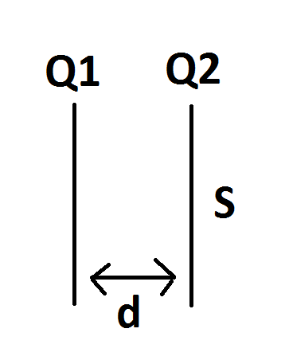
Conductor
energy
There is two relatively infinite large plate with surface area S, distance d and charge Q1 and Q2. Find out the potential difference between this two plate. (s>>d^2)

Slide 6
Conductor
Use the method of images to find the potential due to a point charge q placed at a distance d from the center of an ungrounded conducting ball with radius R < d charged with charge Q.

Slide 7
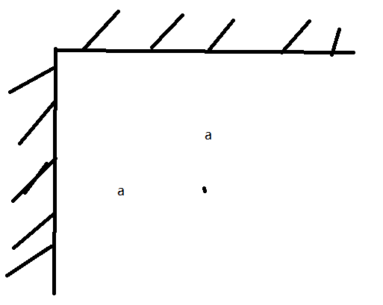
Conductor
There is two half-infinite large conductor plane form a right angle. Both of them are connected to the ground. There is a point charge q. The distances between it and two planes are both a. Find the force on the point charge.

Slide 8
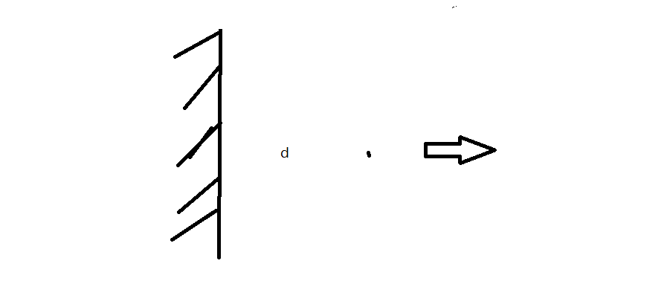
Conductor
There is infinite large plane conductor. A point charge q is located at distance d from the conductor, if I want to pull this point charge to infinite, how much work should I do?

